Slide 1
Predicting Latent Structured Intents from Shopping Queries
Advisor: Jia-Ling Koh
Presenter: You-Xiang Chen
Source: WWW 2017
Data: 2018/11/06

Slide 2
Outline
Introduction
Method
Experiment
Conclusion
Notes:
動機 目的

Slide 3
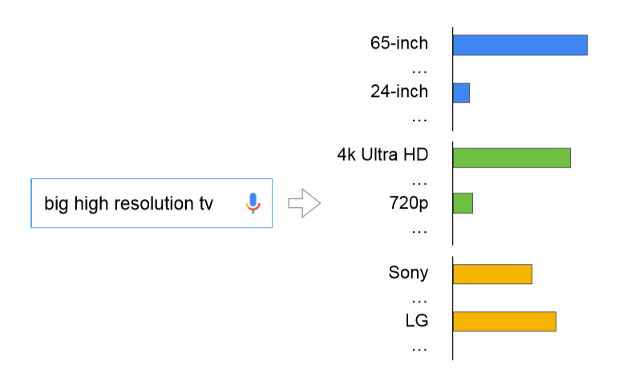
Motivation
resolution

Slide 4
Goal
Understand users’ intent through a structure domain.
Present organized information, and then ﬁnd the items with the right categories, brands or features.

Slide 5
Outline
Introduction
Method
Experiment
Conclusion

Slide 6
Problem Definition
Given input query to predict top attribute

Slide 7
Problem Definition
Predicting a set of associated multi-labels:
$a_{q}=\left(a_{q1},a_{q2},…,a_{qN}\right)∈{\left\{0,1\right\}}^{N}$
Similarly , each product has attribute:
$a_{p}=\left(a_{p1},a_{p2},…,a_{pN}\right)∈{\{0,1\}}^{N}$

Slide 8
Attribute Definition
Feature tags
Age groups
Categories
Brand , product lines and merchants
Notes:
由供應商或網路商城而來

Slide 9
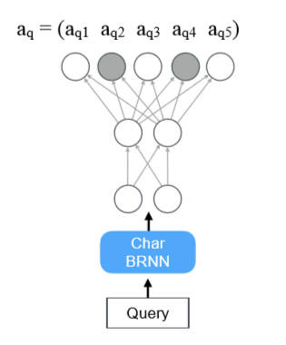
Models
Word-BRNN、Char-BRNN
$x_{t}$ : input sequence , t = 1, … … ,T
$h_{T} :$hidden state of the sequence after observing $x_{t}$
$\vec{h_{T}}=LSTM(\vec{h_{t−1}},x_{t})$
$\overset{⃖}{h_{T}}=LSTM\left(\overset{⃖}{h_{t−1}},x_{t}\right)$
Notes:
由供應商或網路商城而來

Slide 10
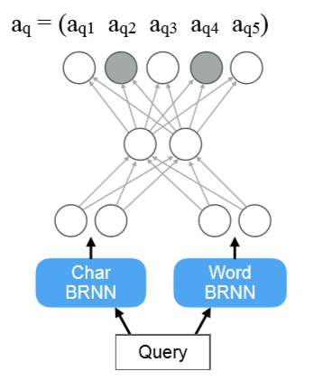
Hybrid network
Hybrid Model
$h^{hybrid} :=\left[\vec{h_{T}^{char}},\overset{⃖}{h_{0}^{char}},\vec{h_{T}^{word}},\overset{⃖}{h_{0}^{word}}\right]$
${\hat{a}}_{q}=σ\left(W_{dec}∙φ\left(W_{fusion}∙h^{hybrid}\right)\right)$
Minimize loss
$L_{query}=−\sum_{q∈Q}{\sum_{i∈[1,N]}{{ a}_{qi}}\log\left({\hat{a}}_{qi}\right)+(1−a_{qi})log⁡(1−{\hat{a}}_{qi})}$
Notes:
由供應商或網路商城而來

Slide 11
Joint Networks
Product network
Given a product by a set of attributes :
$a_{p}=\left(a_{p1},a_{p2},…,a_{pN}\right)∈{\{0,1\}}^{N}$
Training an autoencoder
${\hat{a}}_{p}=σ(W_{dec}∙φ(W_{enc}∙a_{p}))$
Minimize loss
$L_{product}=−\sum_{p∈P}{\sum_{i∈[1,N]}{{ a}_{pi}}\log\left({\hat{a}}_{pi}\right)+(1−a_{pi})log⁡(1−{\hat{a}}_{pi})}$
Notes:
由供應商或網路商城而來

Slide 12
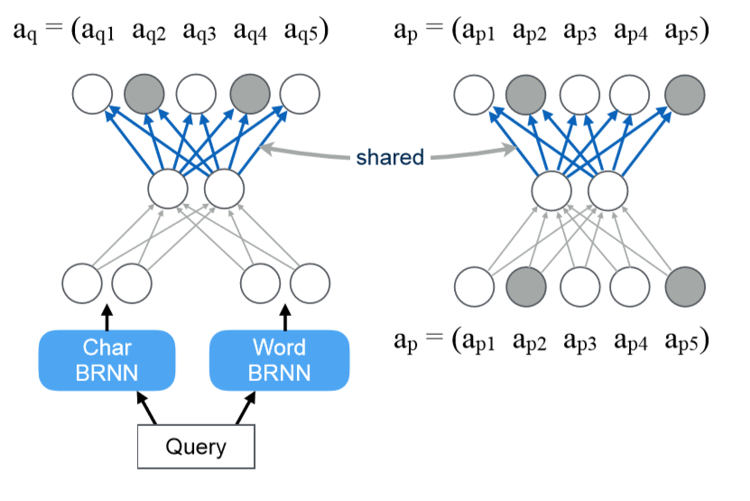
Jointly Training
Share parameters in the attribute embedding layer ($W_{dec}$)
Minimizing the joint loss
$L_{joint}=L_{query}$+$λL_{product}$
Notes:
由供應商或網路商城而來

Slide 13
Outline
Introduction
Method
Experiment
Conclusion

Slide 14
Dataset
Collected at Google shopping
150 million queries
About 30,000 attributes are considered

Slide 15
Prediction accuracy and size

Slide 16
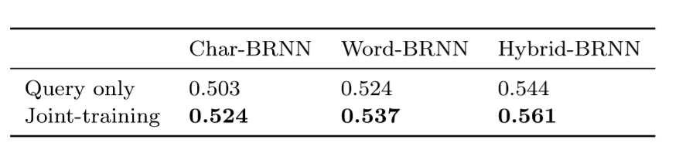
F1 Score of Jointly Training

Slide 17
Unseen model names based on the character pattern of a word

Slide 18
Model complex abstract queries

Slide 19
Extrinsic evaluation on IR
Generated from Google IR system
Consists of about 200,000 queries
10-point scale from “very irrelevant” to “very relevant”

Slide 20
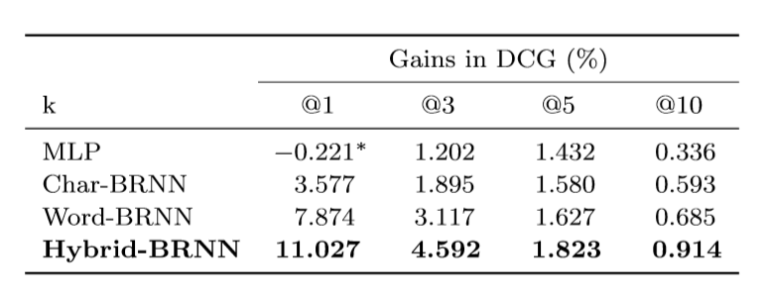
Discounted cumulative gain (DCG)
$DCG@n= r_{1}+\sum_{i=2}^{n}{\frac{r_{i}}{\log_{2}{(i)}}}$

Slide 21
Joint training brings greater gains in DCG

Slide 22
Examples of re-ranking
${ A}_{d}$: attributes of d respectively
$A_{q}$: top k attributes predicted for q
$s_{qd}^{∗}= s_{qd}∙(1+α\frac{|A_{q}⋂A_{d}|}{A_{q}})$

Slide 23
CONCLUSION
We propose a jointly trained hybrid RNN-autoencoder that learns from user responses and product metadata simultaneously. This model is more accurate and robust than all baselines, and is able to generalize to unseen queries better.
We show that our model can signiﬁcantly improve the quality of current Google Shopping production system.

